Slide 1

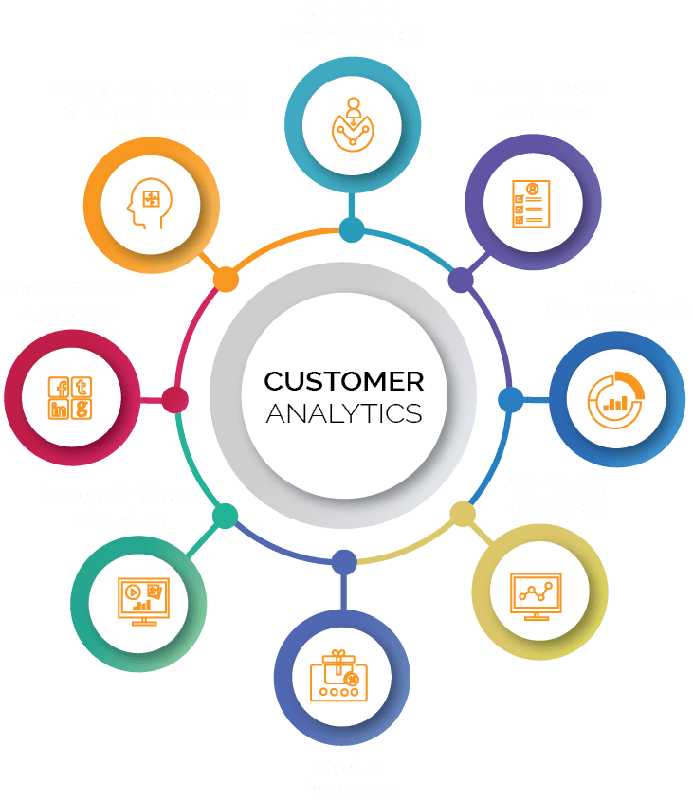

Customer Data Analysis
Power BI Project
Project Id : - PRDA-05
Team Id : - PTID-CDA-DEC-25-958
Team Members:
Ankit Raj Sinha
Lolla Venkata Surya Sudheer Kumar
Gangula Padma
Gangapatnam Vidyasagar

Slide 2

Project Overview
• Project Name: Customer Data Analysis
• Tool Used: Power BI
• Objective: Analyze customer behavior, sales trends, and payment preferences
• Dataset: Shopping Mall Customer Data

Slide 3
Project Objectives
• Understand customer purchase behavior
• Identify high-performing product categories
• Analyze age, gender, and payment patterns
• Support data-driven business decisions

Slide 4

Key Performance Indicators (KPIs)
• Total Quantity Sold
• Total Revenue Generated
• Category-wise Sales
• Age-wise & Gender-wise Distribution
• Payment Method Analysis

Slide 5
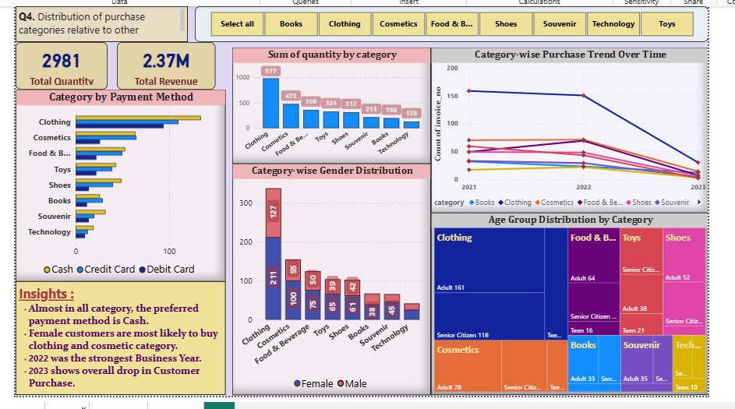
Category-wise Sales Analysis

Slide 6
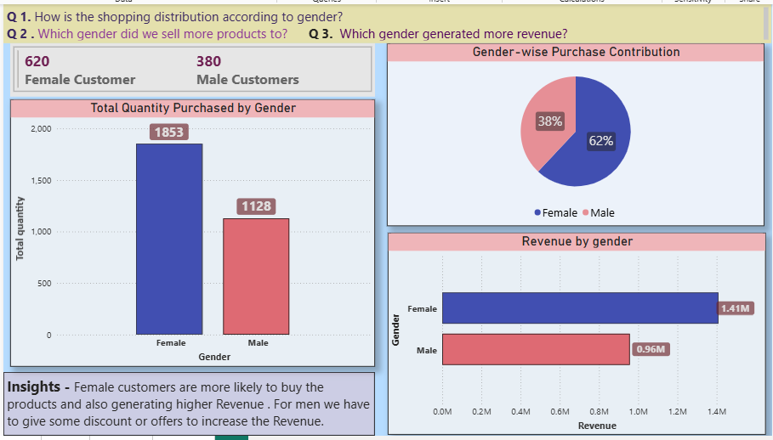
Gender wise Shopping Distribution

Slide 7
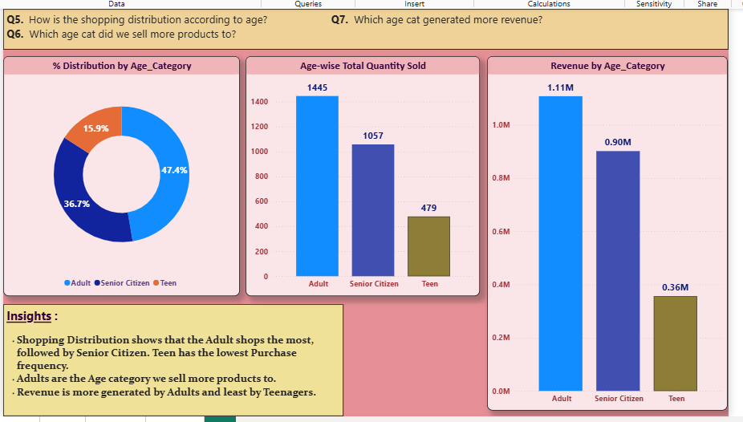
Revenue & Quantity by Age Group

Slide 8
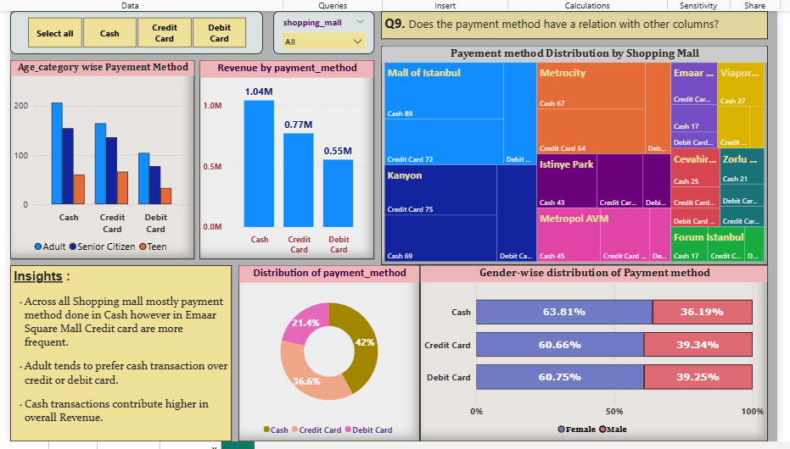
Payment Method Analysis

Slide 9

Key Insights
• Cash is the most preferred payment method overall
• Adults contribute the highest sales and revenue
• Clothing and Cosmetics are top-selling categories
• 2022 was the strongest business year
• Overall decline in customer purchases observed in 2023

Slide 10

Conclusion
• Customer behavior varies significantly by age and category
• Payment method insights can help optimize transaction strategies
• Business can focus on adult segment and popular categories to boost revenue
Notes:
------------------------------------------------------------------------------------ Thank You ---------------------------------------------------------------------------------------------

